Slide 1

Next version of
the technical manual
Towards a collaborative integration with GitHub
Stephan Bracke

Slide 2
What we want to achieve
Make it possible to contribute on GitHub in the same way as for the intermagnet website
Have full version control on it and make it available as
  HTML web site
  Downloadable pdf
Make this as automated as possible.

Slide 3
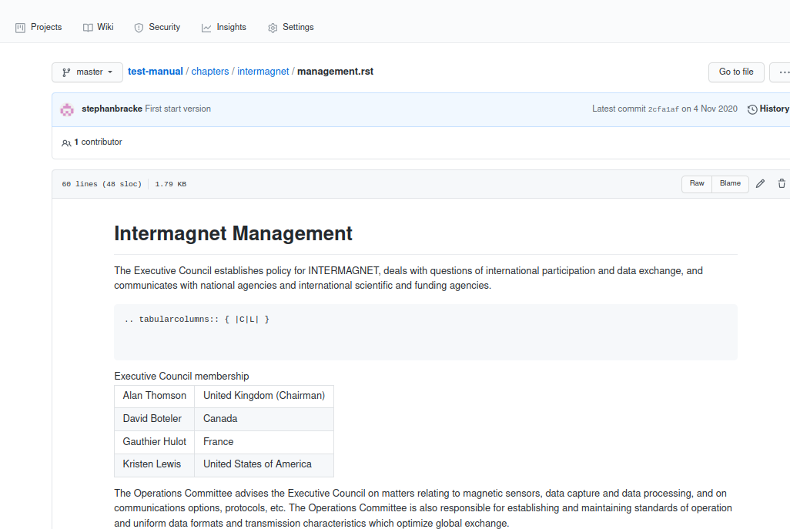
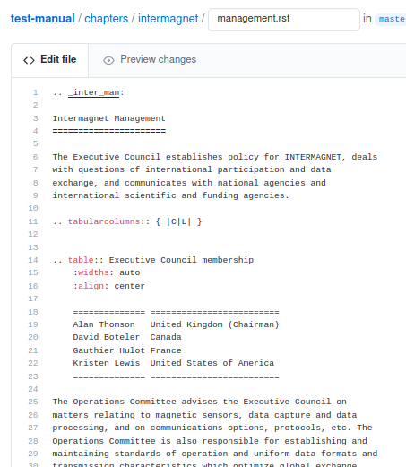
ReStructured Text as basic files

Slide 4
Why not use Mark Down
Mark down is limited to simple web pages
RST adds the possibilities to plugin directives :
Mark down lacks the possibilities to produce documents with table of content auto numbering and referencing

Slide 5
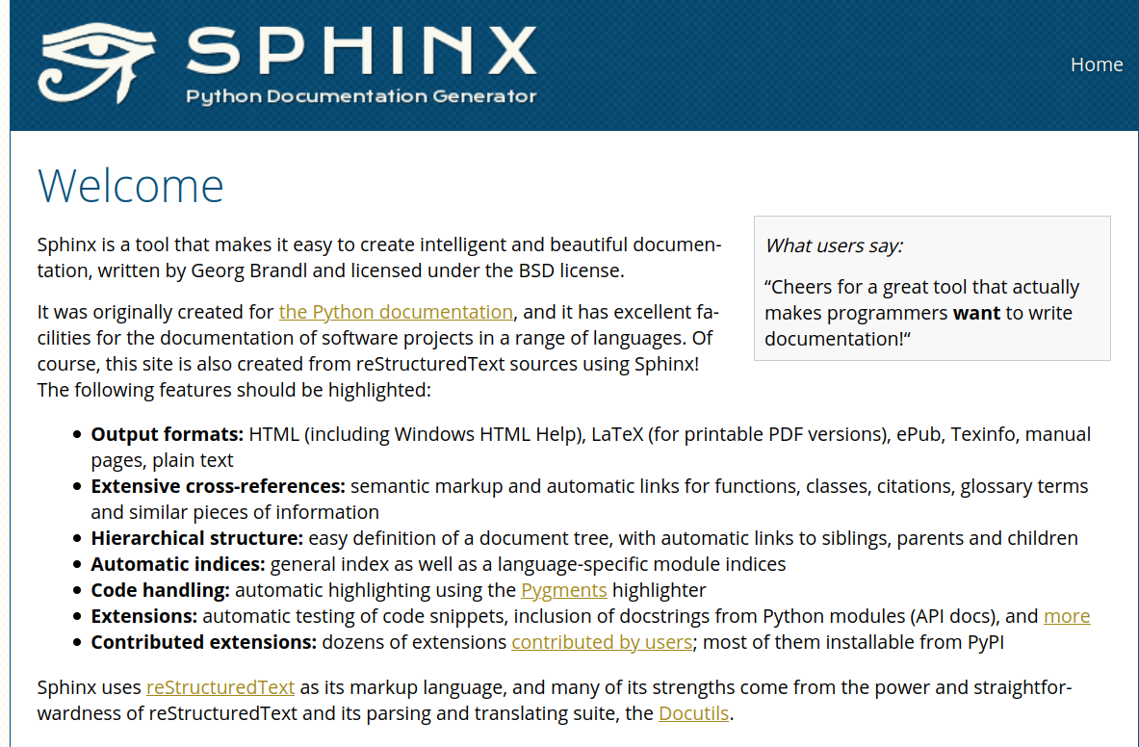
Sphinx to power up RST

Slide 6
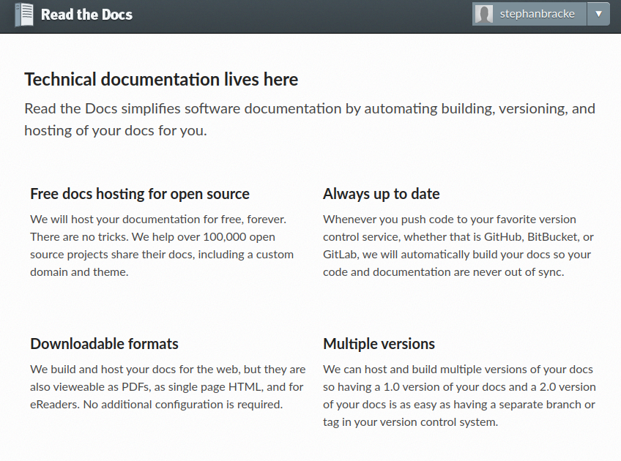
Readthedocs.org

Slide 7
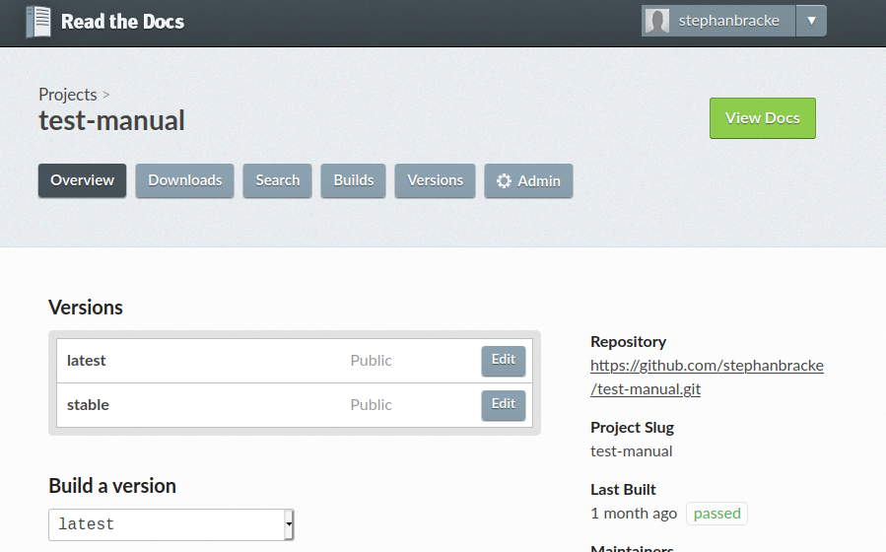
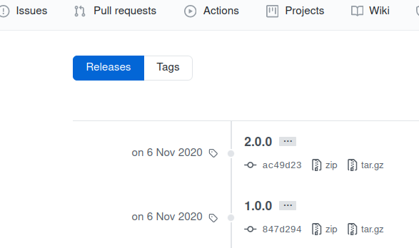

Slide 8
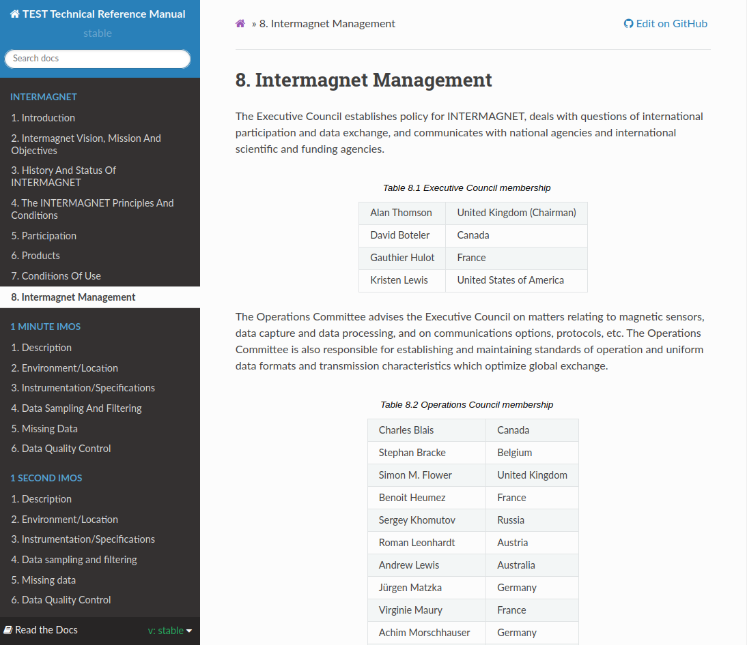
Automated build: website

Slide 9
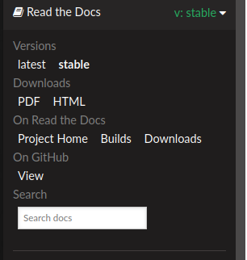
Automated build: website
https://test-manual.readthedocs.io

Slide 10
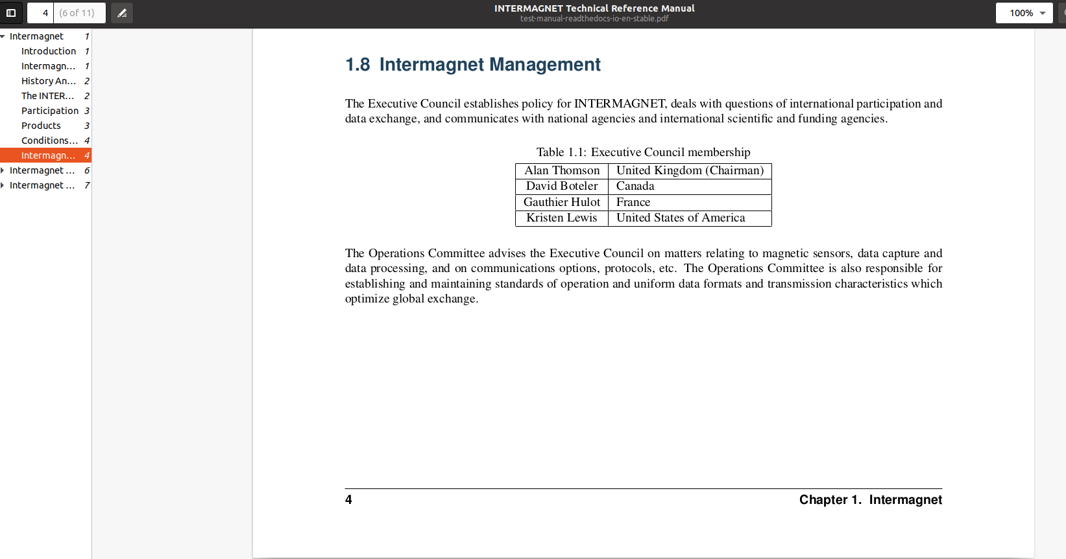
Automated build: PDF

